Slide 1


SPAMSHIELD: SMS SPAM DETECTION

Slide 2
INTRODUCTION
In this SMS Spam Detection project, we tackle the problem of filtering unsolicited spam messages by employing machine learning models—Support Vector Machine (SVM) and Naive Bayes. With spam posing both privacy risks and message clutter, an effective automated solution is crucial. SVM seeks to maximize the separation margin between spam and non-spam messages, making it robust for text classification, while Naive Bayes, a probabilistic classifier, efficiently predicts spam likelihood based on word frequency. Through comparing these models on key metrics like accuracy and precision, we aim to identify the most effective approach, enhancing communication safety by minimizing spam in SMS inboxes.

Slide 3
PROBLEM
The rise of spam messages in SMS inboxes presents challenges in privacy and user experience. This project aims to develop an automated, accurate system for spam detection using SVM and Naive Bayes classifiers to efficiently classify messages as "Spam" or "Not Spam," improving message security and usability.

Slide 4
OBJECTIVE
To detect spam messages using machine learning techniques.
Provide a simple GUI for real-time spam classification.

Slide 5
SVM
Objective: SVM (Support Vector Machine) is used to classify messages by finding the best boundary (hyperplane) that separates "Spam" from "Not Spam" messages.
Process:
Feature Transformation: Text messages are transformed into numerical vectors using TF-IDF to capture word importance.
Optimal Hyperplane: SVM identifies a hyperplane that maximizes the margin between spam and non-spam classes, aiming for high accuracy in classification.
Linear Classifier: Using a linear kernel and hinge loss function, SVM efficiently handles high-dimensional, sparse data typical in text processing.

Slide 6
NAIVE BAYESIAN
Objective: Naive Bayes is a probabilistic classifier that uses Bayes' Theorem to calculate the likelihood of a message being "Spam" or "Not Spam" based on word frequency.
Process:
Feature Transformation: Text data is vectorized using TF-IDF, transforming each message into a frequency-based representation.
Probability Calculation: Naive Bayes calculates the probability of each word occurring in spam and non-spam messages, assuming words are independent (the "naive" assumption).
Classification: Based on these probabilities, the model assigns a message to the class (spam or not spam) with the highest likelihood.

Slide 7
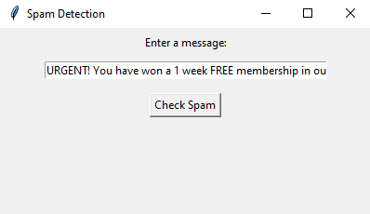
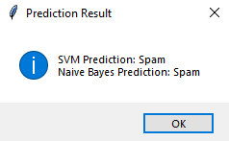
RESULT

Slide 8
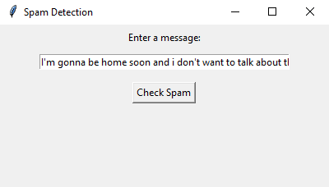
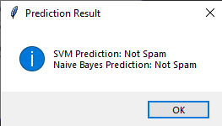
RESULT

Slide 9
CONCLUSION
In this project, we successfully implemented a machine learning-based SMS spam detection system using Support Vector Machine (SVM) and Naive Bayes classifiers. Both models demonstrated reliable accuracy in distinguishing between spam and legitimate messages by analyzing text patterns, enabling efficient and automated spam filtering. The SVM model excelled in identifying distinct boundaries between spam and non-spam messages, while Naive Bayes provided fast and effective classification through probability-based analysis. The inclusion of a user-friendly GUI using Tkinter enhances accessibility, allowing users to easily test messages in real-time. This project highlights the potential of machine learning for text classification and sets a foundation for future improvements, such as expanding to web or mobile applications for broader usability.

Slide 10
Thank You

